Slide 1


Film Venture
By: Rafael V Rabinovich
Phase 1 Data Science project
Flatiron School

Slide 2

To the Microsoft BOD
Using Analysis and knowledge of the business to:
Provide a comprehensive assessment of the film industry
Helping Microsoft make an informed decision on how to enter this field
Making recommendations on Film production

Slide 3
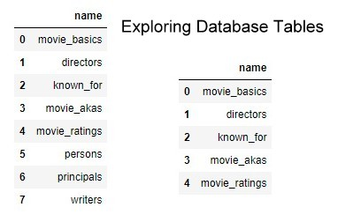
Exploring Databases and Tables
Exploring data on movies
Using Python and SQL

Slide 4
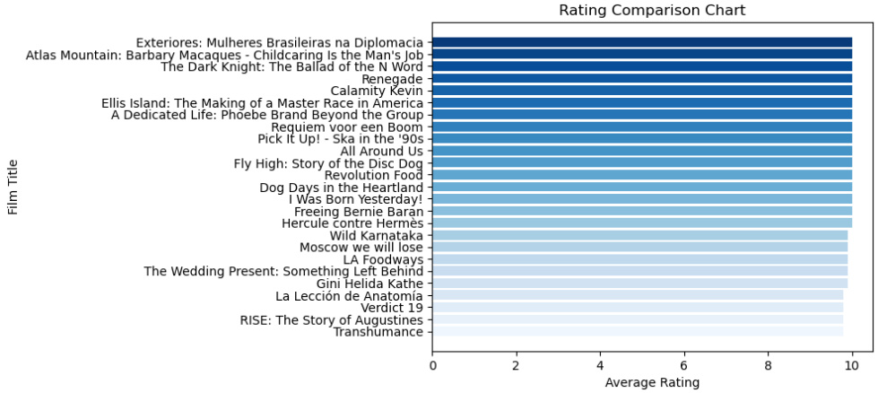
Best Rated Movies
From the IMDb database
Highest Rating Movies

Slide 5
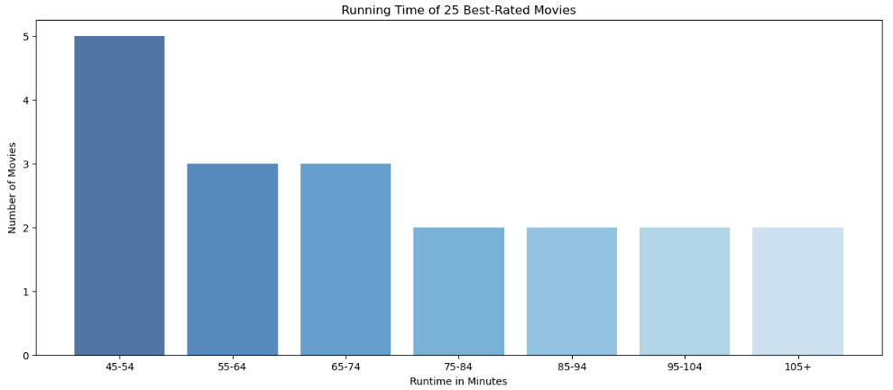
Runtime
Length in minutes
Top 25 best-rated

Slide 6
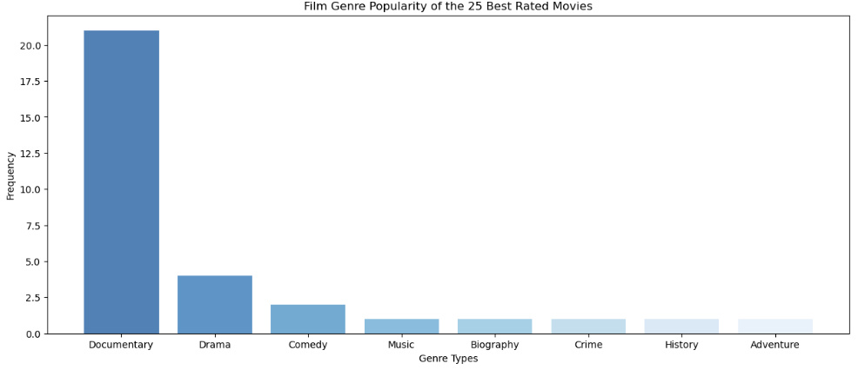
Breakdown by Genre
Documentaries:
Best-Rated Genre

Slide 7

But, is this of use to our stakeholders?

Slide 8
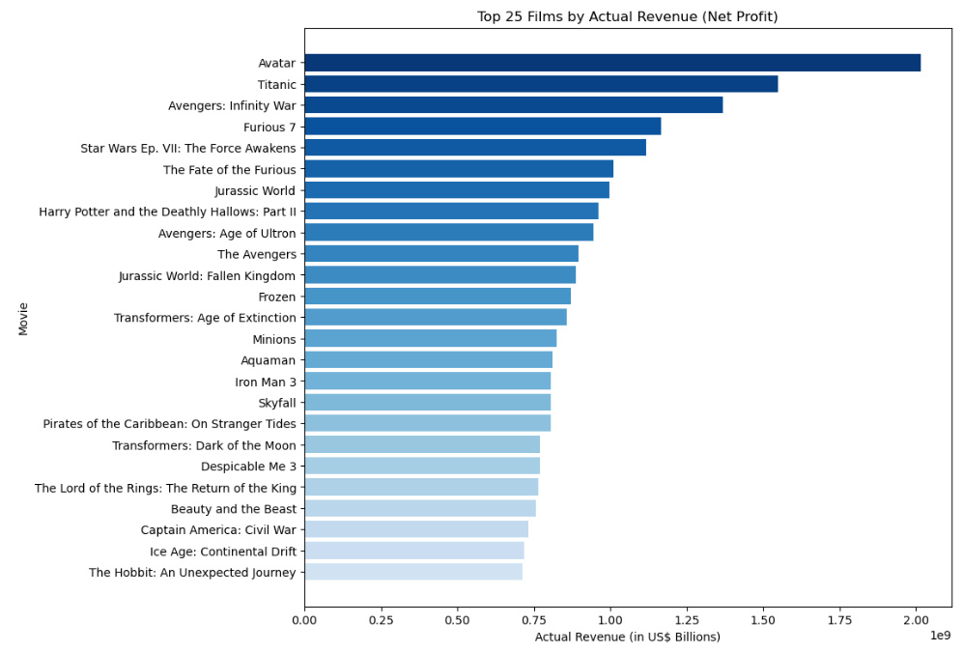
A better look
A much greater audience
(Total Revenue) minus (Production Cost) = Actual Revenue (Net Profit)
Top 25 Actual Revenue Movies!

Slide 9
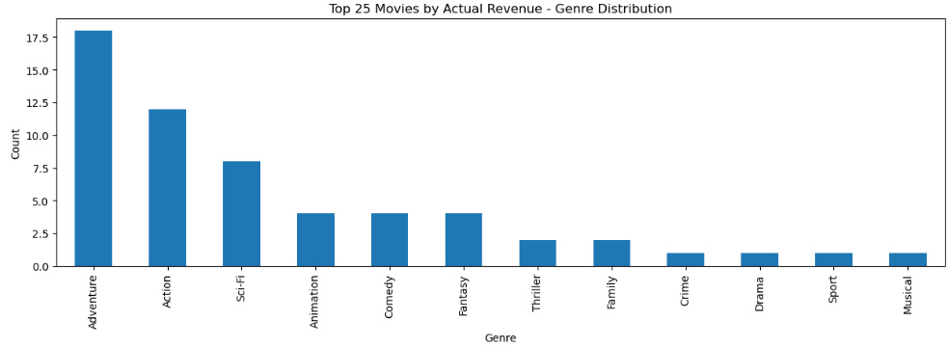
Genre Distribution

Slide 10
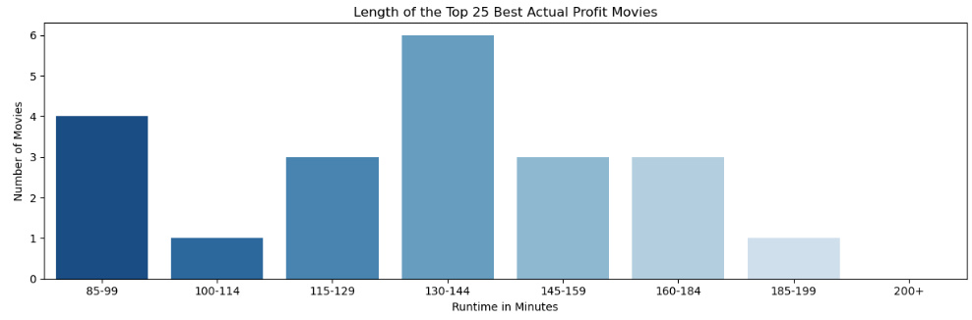
Runtime Length

Slide 11
Conclusion
Most Profitable Genres:
Action
Adventure
SciFi
Runtime: 130 minutes
Best-liked genre:
Documentaries
Runtime: 45 – 55 m

Slide 12
Recommendations
Invest first in Action, Adventure and Sci-Fiction Film
Keep the runtime within 130 to 145 minutes
Once financial goals are achieved:
Produce Documentaries
This make you likable by culture audiences

